Slide 1

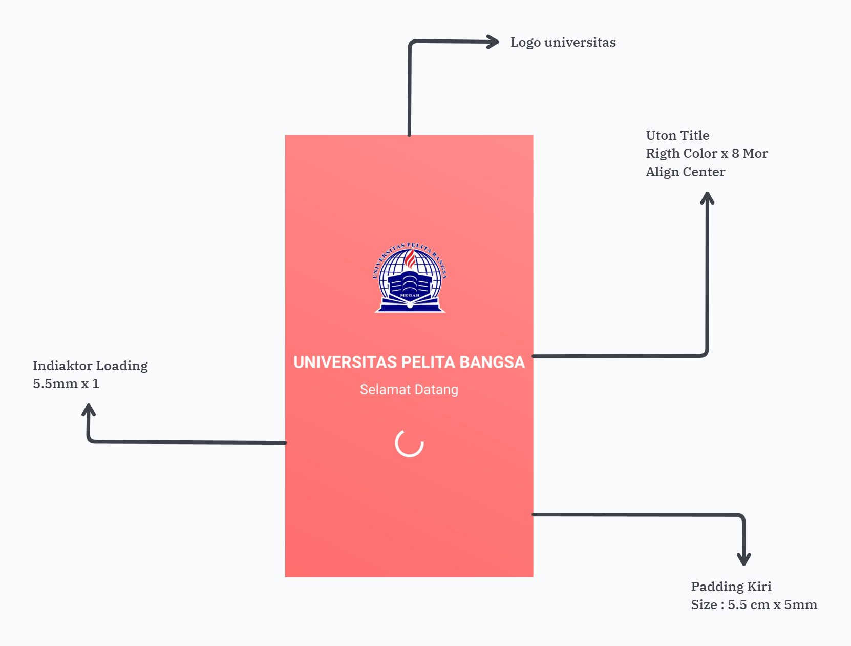
Pendaftaran Universistas
UX (User Experience)

Slide 2

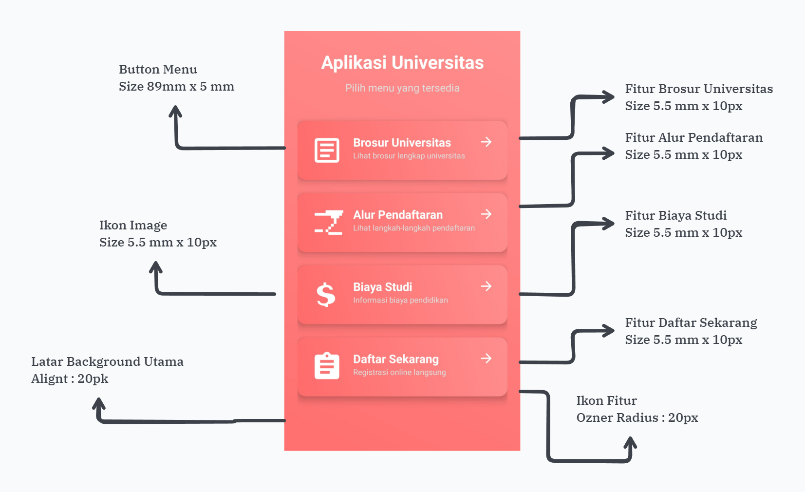
Pendaftaran Universistas
UX (User Experience)

Slide 3

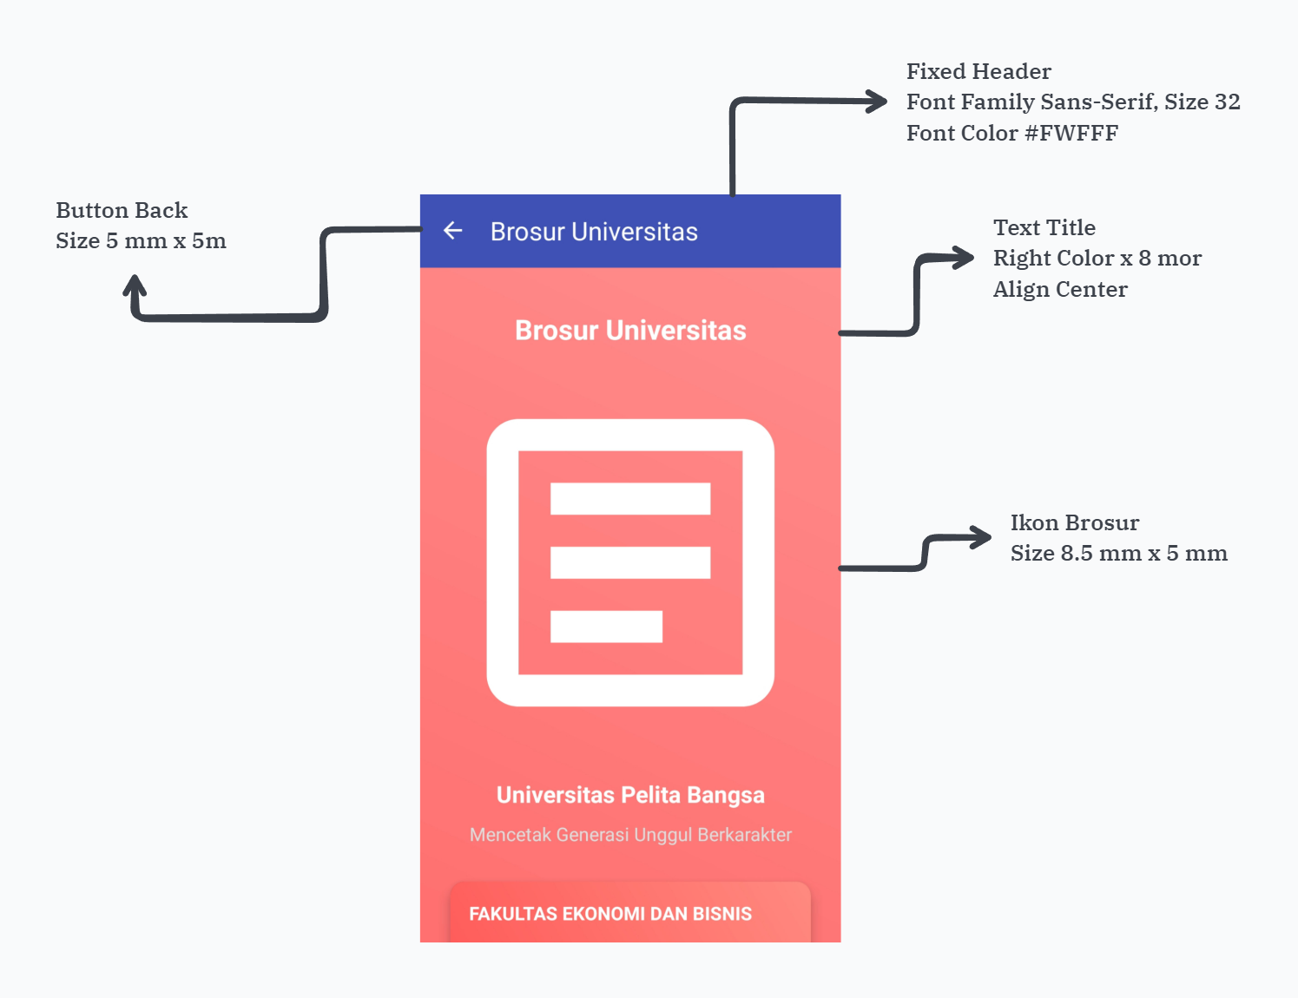
Pendaftaran Universistas
UX (User Experience)

Slide 4

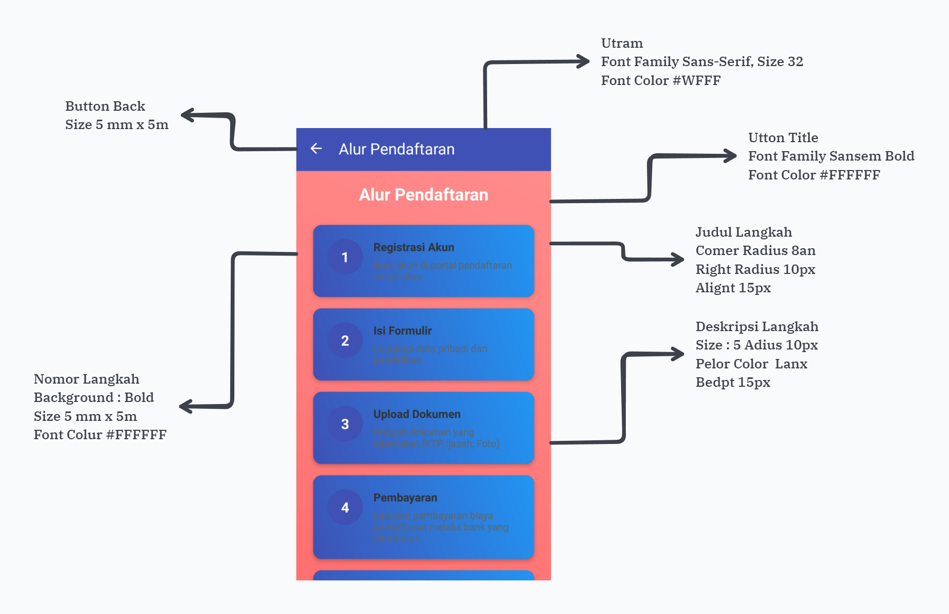
Pendaftaran Universistas
UX (User Experience)

Slide 5

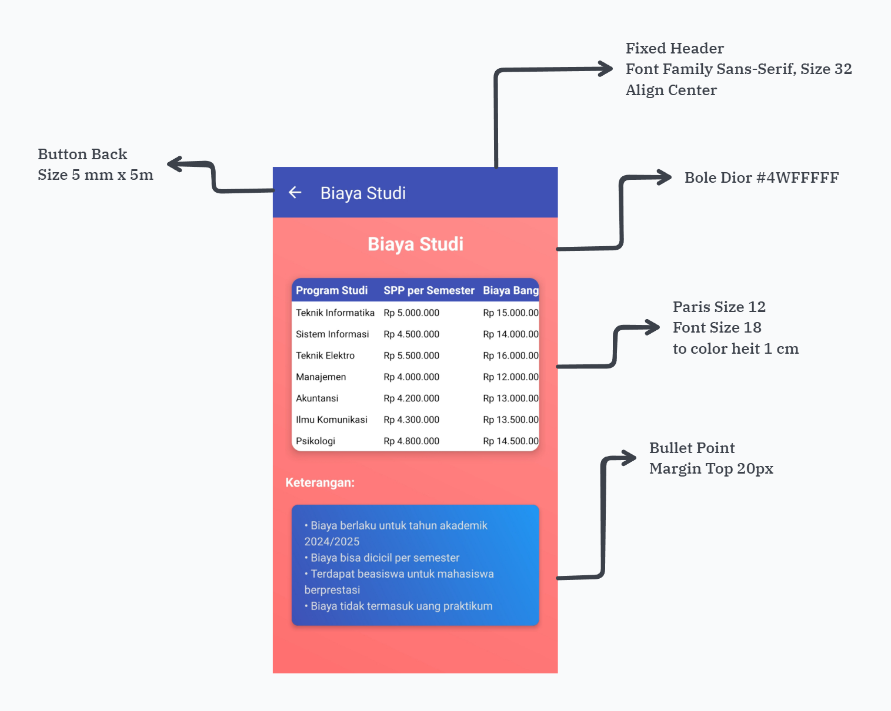
Pendaftaran Universistas
UX (User Experience)

Slide 6
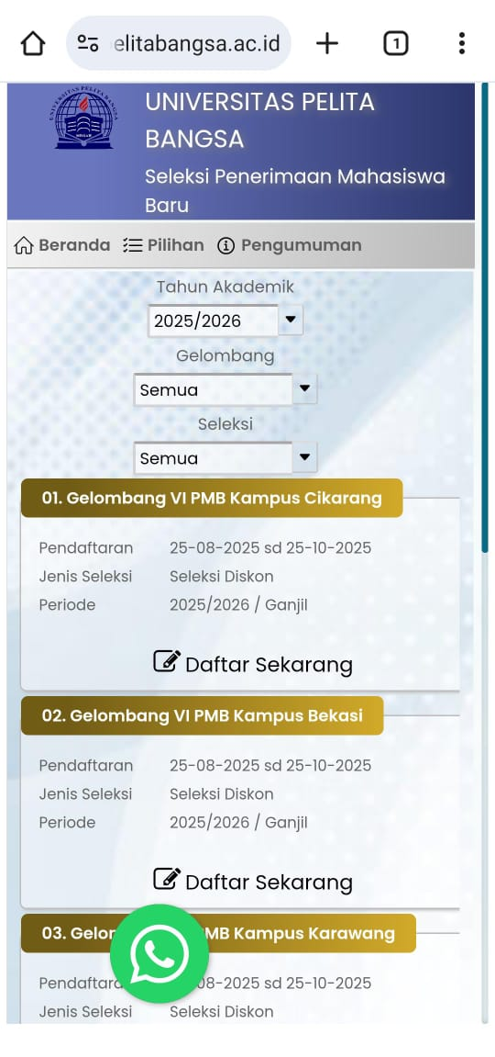
Pendaftaran Universistas
UX (User Experience)

